Slide 1
FARMERS HELP
GUIDE : DR SABITHA S
SUBMITTED BY
ANJANA PT
MCA S3
TVE20MCA-2015

Slide 2
INTRODUCTION
Farmers Help is a
Flexible software package which contains numerous potent features that makes the activities of farmer management easier than ever.
Web application intended to manage different farming requirements like crops, techniques used, selling and buying products etc.
Seven types of users interact with the project.

Slide 3
OBJECTIVE
Coordinate different events under one roof.
Customization of farming package; here the users can select the required options regarding the farming requirements.
The primary objective is to provide a fast and reliable system for farming fields and to make all the processes more efficient, speedy and secure by automating the system.

Slide 4
  EXISTING SYSTEM
Currently, the farmer goes to nearest market handover his product to a particular agent, agent ask the farmer to visit the market after a specific time to collect the cash earned out of the sold product.
Agent sells the product to another agent or a dealer at the cost of that market.

Slide 5
DRAWBACKS OF EXISTING SYSTEM
There is no way for farmer to know about the deal and the exact amount at which their product was sold.
There is no transparency. No facility to know the product price in different markets where farmers can sell their products for high profit.

Slide 6
Man power is required to maintain records.
While preparing the details manually, it takes lot of time and effort
It is very slow process.
No efficient facilities for farmer management and other activities of other users.

Slide 7
  PROPOSED SYSTEM
The website is a one point solution for helping farmers.
Farmers can avail capital assistance from the outset by requesting an amount from interested investors.
Then they can purchase seeds online .
The equipment for farming can be purchased from the same website.
Also the pesticides for cultivation can be purchased from the site.

Slide 8
The farmers can ask doubts from agriculture experts so that they can take better care of their crops and improve their yield.
Suppliers can add the product details like price, description, quantity to the site. They can view the bookings of their products.
Once the harvest starts, farmers can sell it online.
Thus the site provides the farmer a complete solution.

Slide 9
  ADVANTAGES OF PROPOSED SYSTEM
Through a website like this, farmers can connect directly with customers and make their transactions profitable for them without a middleman/third party.
Stores the information about all users and Registered users can view and modify their profile.
Provides instant access to information.

Slide 10
USERS ARE
    Farmers
    Exporters
    Investors
    Suppliers
    Specialist
    Public
    Admin

Slide 11
MODULES ARE
Farmers
    Registration
    Add crops
    Purchase products
    Add Farming Techniques
    Chat with specialist
    Request capital

Slide 12
Suppliers
    Add product details
    View Booking
    Add Feedback
Specialists
    View Enquiries
    Respond to enquiries
Exporters
    Add order
    View products

Slide 13
Investors
    Invest Money
        People who want to invest in agriculture can register so they can help farmers.
Public
    Registration
    Purchase products
    View products
    Add feedback
    View farming techniques

Slide 14
CONTEXT DIAGRAM / LEVEL 0

Slide 15
ADMIN
FARMER
Request
Response
Response
Request
FARMERS_HELP
SPECIALIST
Request
Response
PUBLIC
Response
Request
Request
Response
Response
Request
Response
Request
EXPORTERS
SUPPLIERS
INVESTORS

Slide 16
LEVEL 1

Slide 17
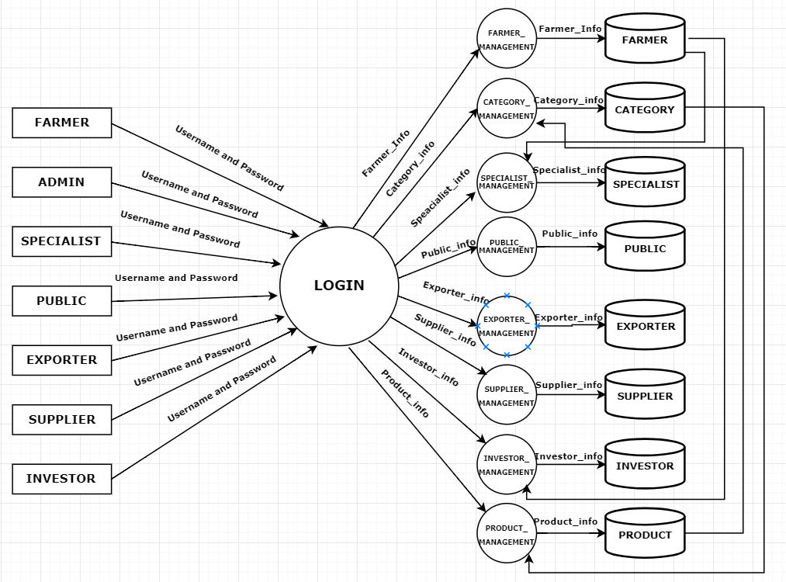

Slide 18
      REFERENCES
Sindhu M R, Aditya Pabshettiwar, Ketan . K. Ghumatkar, Pravin . H . Budhehalkar, Paresh . V . Jaju, “E-FARMING”, G. H. Raisoni College of Engineering and Management, Pune, India., International Journal of Computer Science and Information Technologies (IJCSIT).
Dr M . Rajarajeswari , “AGRICULTURE MANAGEMENT SYSTEM USING – PYTHON”, December 2019, Journal of The Gujarat Research Society.

Slide 19
Megha Nayak, Pinky Wankhede, Neha Khapekar, Komal Dhote., “E-COMMERCE SITE FOR AGRICULTURE PRODUCTS”.,April 2019, Dept. of Computer Science & Engineering, Nagpur Institute of Technology college, Maharashtra, Nagpur., International Research Journal of Engineering and Technology (IRJET)

